Slide 1
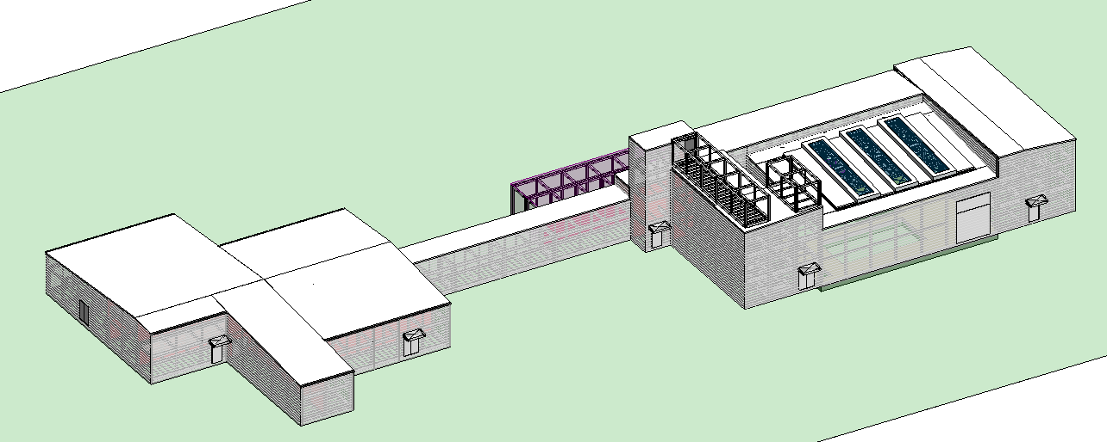
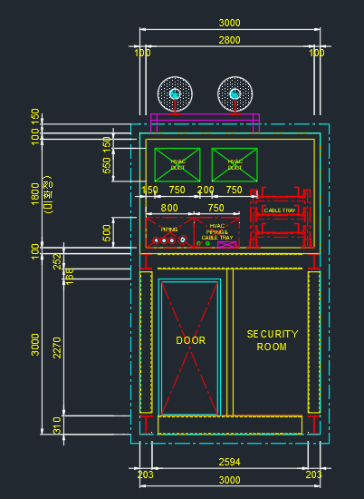
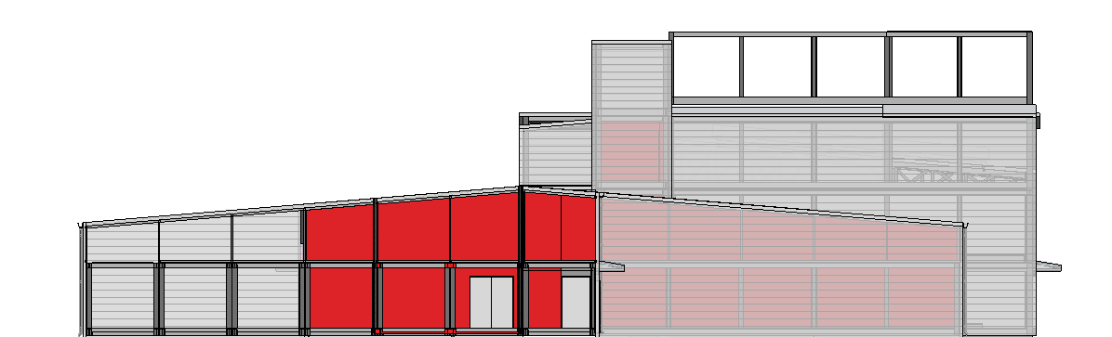
MMR Modularization
5
Roof Design Concept
■ Overall Roof Design
B’
A
B
■ Sectional Planning (B-B’)
A’
Molten Salt Pipe
■ NP Cross Section (A-A’)
Duct
Cable
Pipe
1:12 SLOPE
1:12 SLOPE
Access
Roof Module
(Max. 3m height)
Standard Module

Slide 2
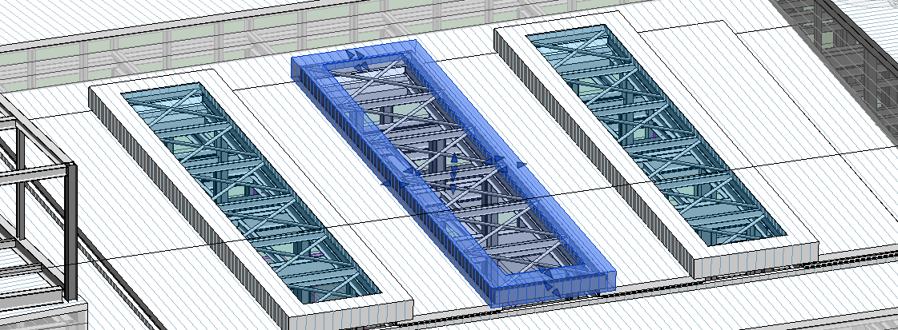
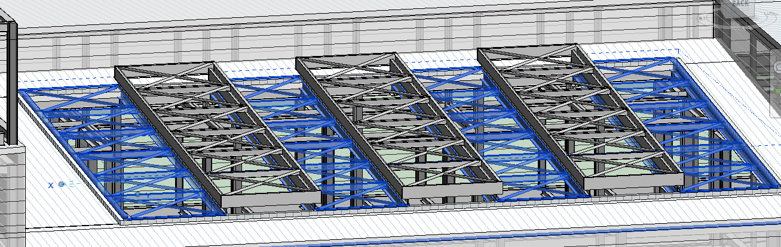
MMR Modularization
5
Roof Design Concept
■ Removable Roof Panel for Turbine Hall
■ Removable Roof Panel (Frame View)

Slide 3
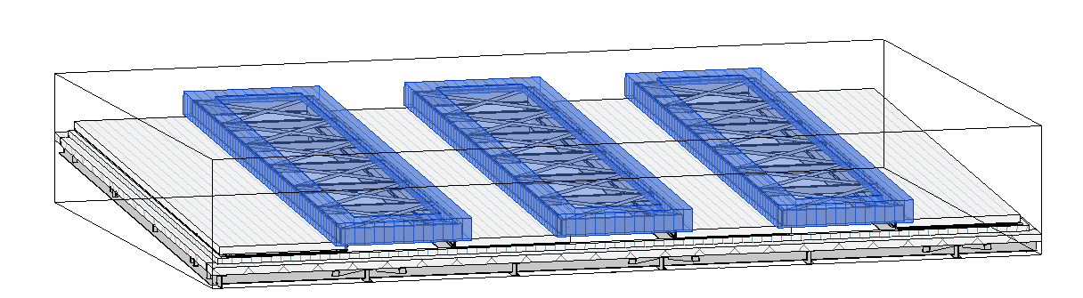
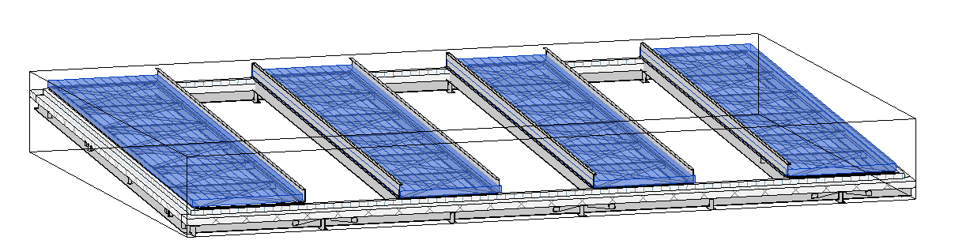
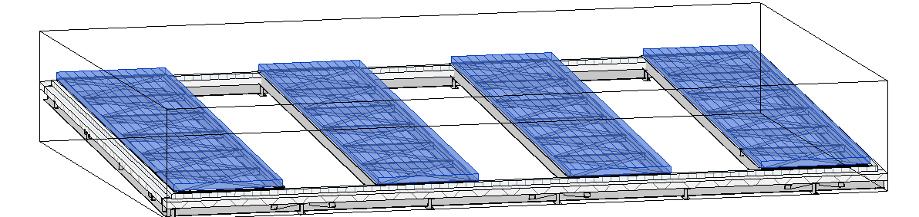
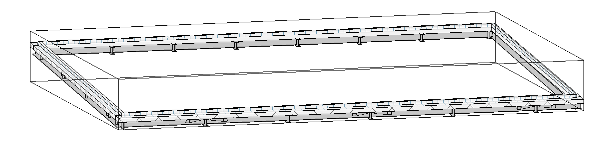
MMR Modularization
5
Roof Design Concept
■ Removal Sequences
Sequence-1
Sequence-2
Sequence-3
Removable Area
Roof Opening
(16.5m x 11.0m)

Slide 4
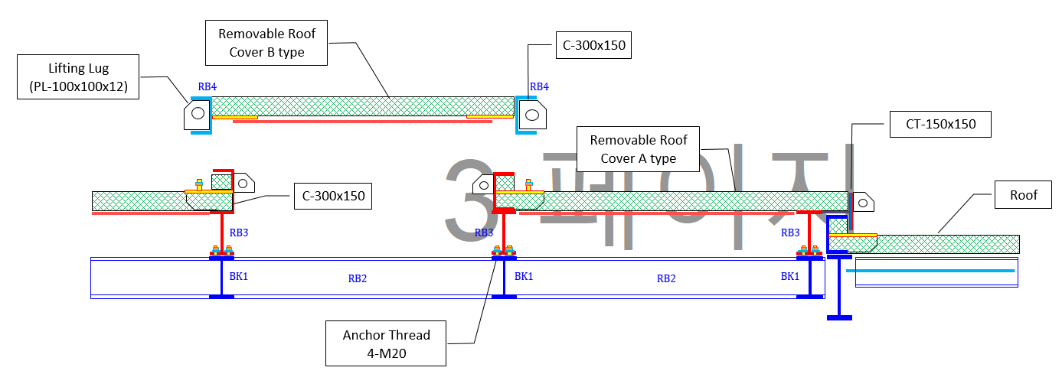
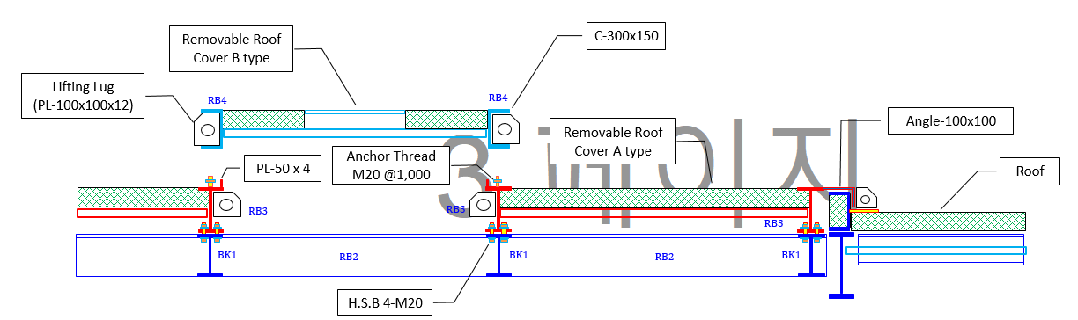
MMR Modularization
5
Roof Design Concept
■ Removable Roof Panel (ALT-1)
■ Removable Roof Panel (ALT-2)

Slide 5
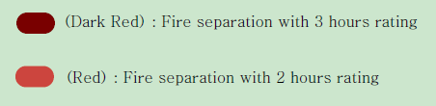
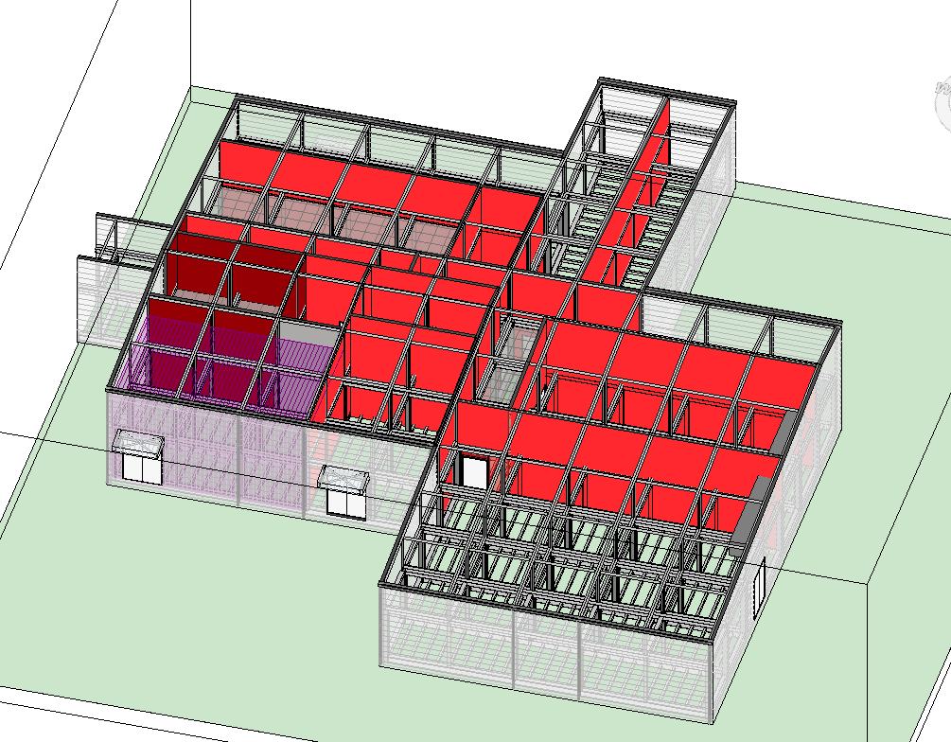
MMR Modularization
5
Passive Firefighting Design
■ Fire Separation for NP Building
[Fire barrier between NP and AP]
Fire separation : 3 hrs
Code : NFPA 804
[Waste Room]
Fire separation : 2hrs
Code : CSA N293-12, NBCC
[Change & Changeover Room]
Fire separation : 2hrs (min. 1hr)
[Reactor EQ Room]
Fire separation : 2hrs
Code : -
[Decontamination Room]
Fire separation : 2hrs
[MCR]
Fire separation : 3hrs
Code : NFPA 804
[Gas Extinguish Room]
Fire separation : 2hrs
[Corridor (Access to SCA)]
Fire separation : 2hrs
Code : CSA N293-12
[Electrical Room]
Fire separation : 2hrs
Code : NFPA 850
[AHU Room]
Fire separation : 1hr
Code : -
[Laydown Storage Room]
Fire separation : 2hrs
Code : CSA N293-12, NBCC
[ACU Room]
Fire separation : 1hrs
Code : -

Slide 6
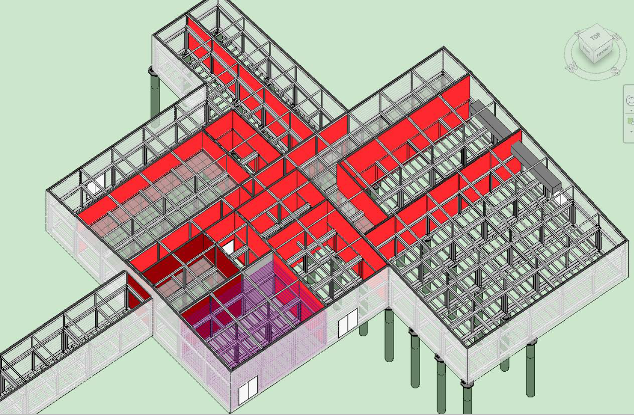
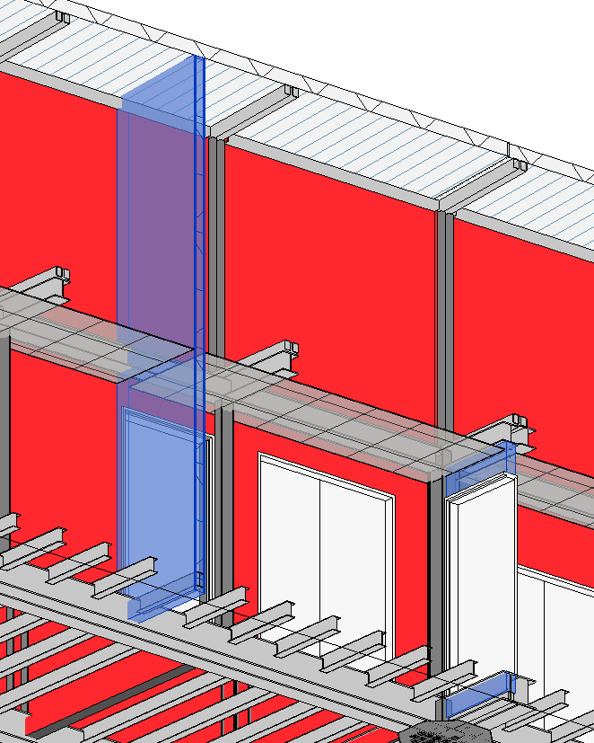
MMR Modularization
5
Passive Firefighting Design
■ Requirements for Fire Separation
Fire Barrier
(Up to Roof Level)
Roof
Void Space
Ceiling
Partition wall
(Up to Ceiling Level)
Corridor
Most conservative case(time) for each fire separation wall shall be adopted.
For vertical continuity, all fire separation walls shall continue up through the ceiling and void space, so as to terminate tightly against the underside of the floor / ceiling assembly.
Penetration seal (around openings for duct, cable tray, or pipe), having fire resistance rating not less than required time for the separation wall, shall be provided.

Slide 7
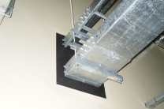
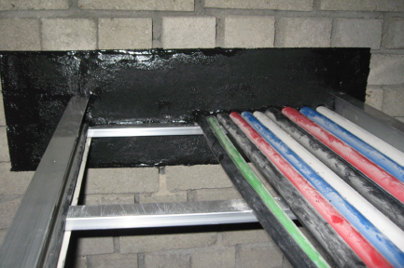
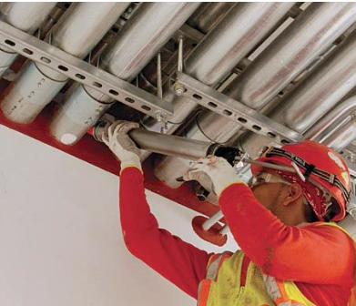
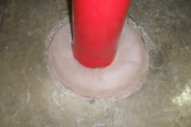
MMR Modularization
5
Passive Firefighting Design
■ Sample Photo for Firestop Materials
Low-density Silicon
High-density Grout
RTV Foam
Firestop Sealant
■ Requirements for Fire Separation
For vertical continuity, all fire separation walls shall continue up through the ceiling and void space, so as to terminate tightly against the underside of the floor / ceiling assembly.
Most conservative case(time) for each fire separation wall shall be adopted.
Penetration seal (around openings for duct, cable tray, or pipe), having fire resistance rating not less than required time for the separation wall, shall be provided.

Slide 8
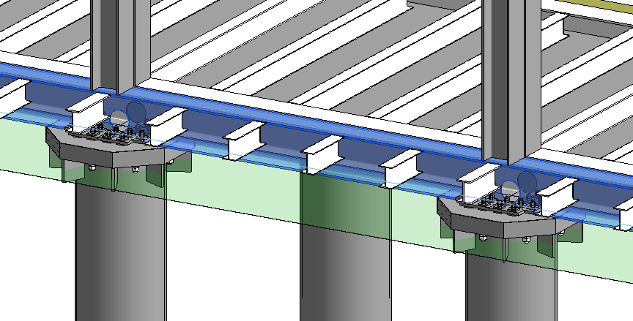
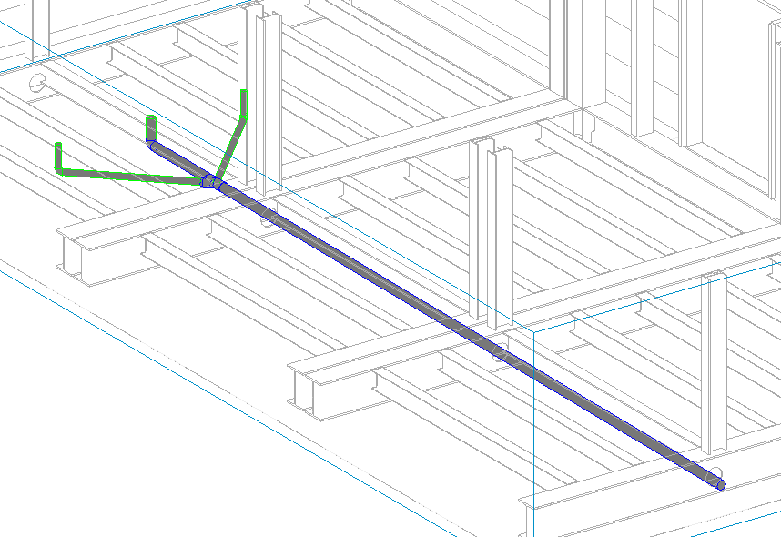
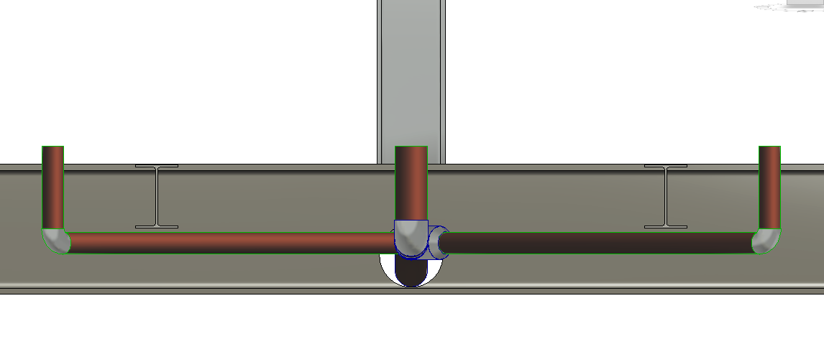
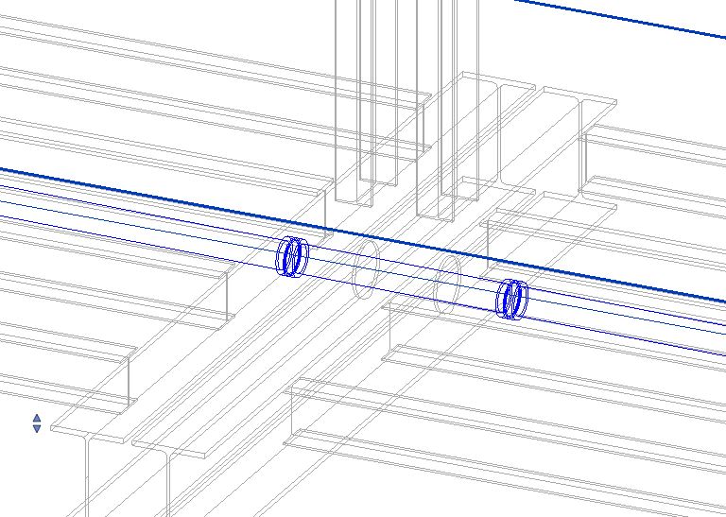
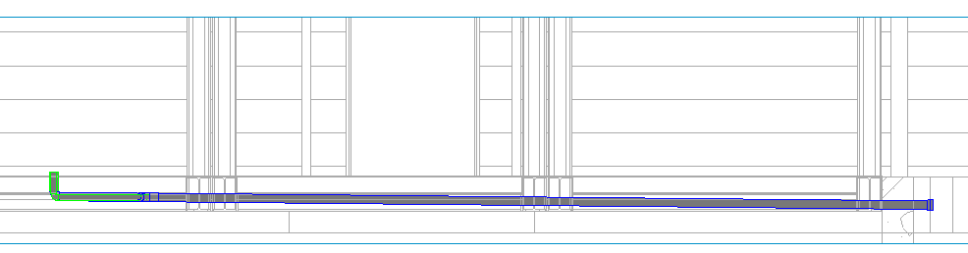
MMR Modularization
5
Drainage System
■ Web opening for steel connection
■ Isometric View for Drain Pipe
Web opening
For steel connection between modules
A1-15-01
A1-15-02
■ Web opening for pipe connection
Cast Iron Pipe with 1:100~500 Slope
Web opening
For pipe connection between modules
A1-15-03
■ Interconnection pipe
■ Section Detail
Connection pipe to be installed at site.
A1-15-01
A1-15-02
A1-15-03
A1-15-02
Ditch
A1-15-03
Connected to Adjacent ditch in Turbine hall

Slide 9
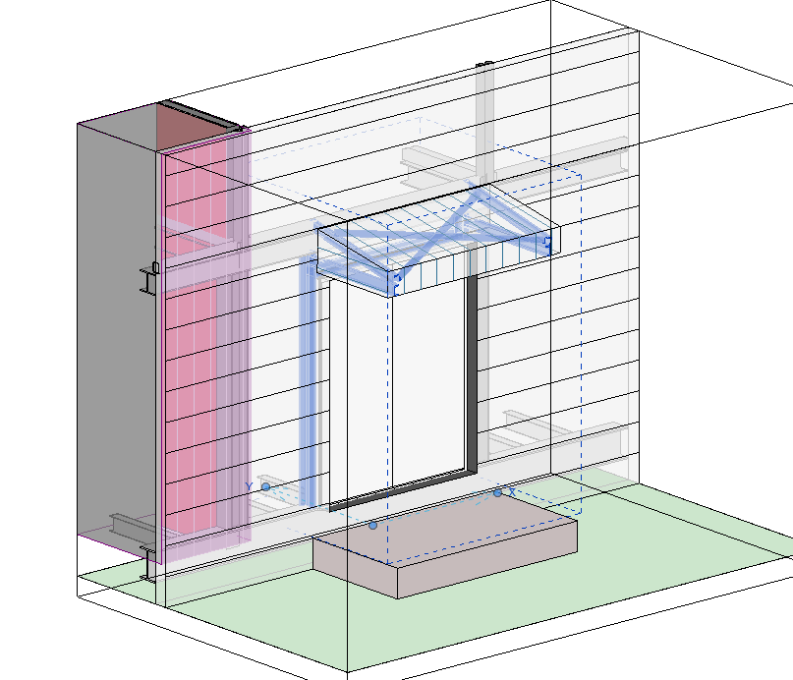
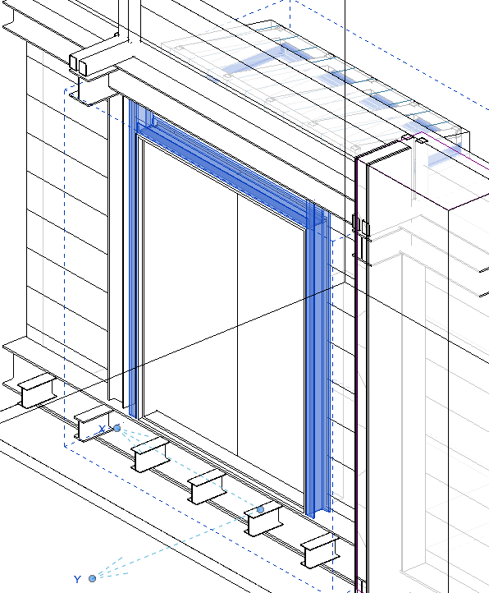
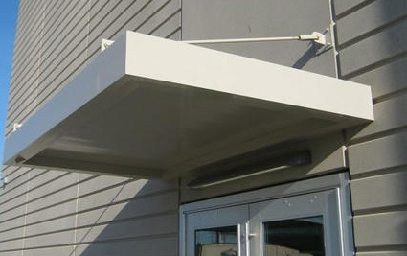
MMR Modularization
5
Canopy Fixing Detail
■ Door Frame Detail
■ Opposite Side
Door Frame supporting the canopy as well as the door
Indoor
Outdoor
■ Example (Option)

Slide 10
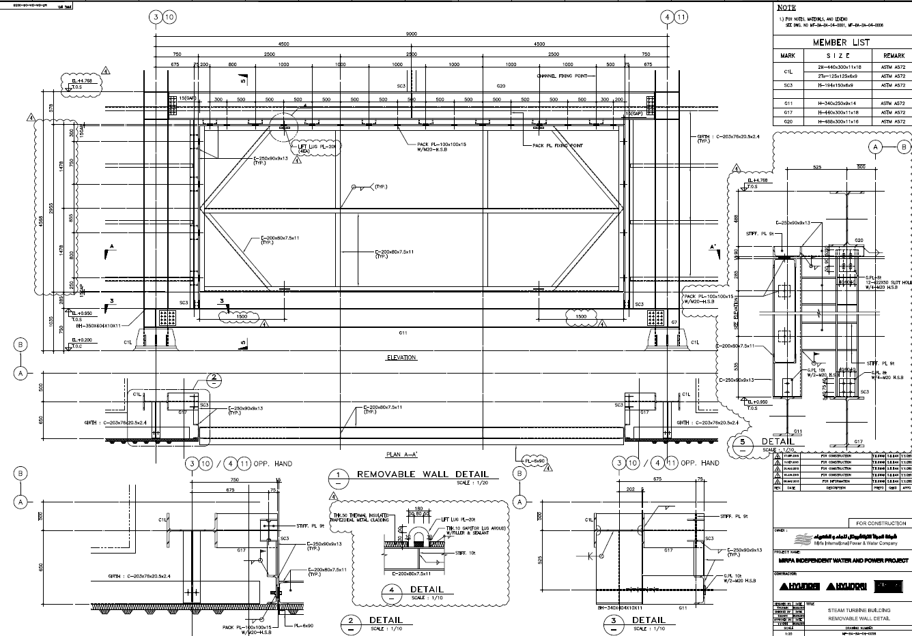
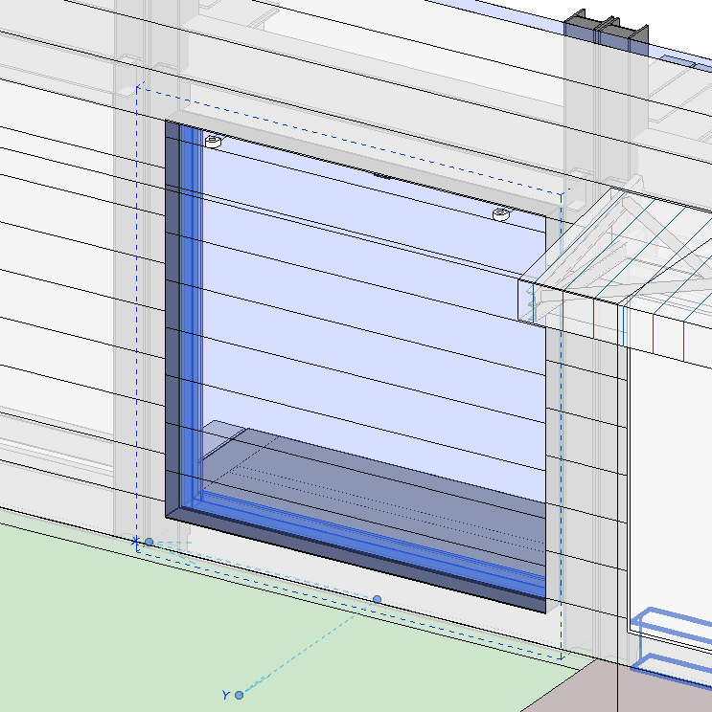
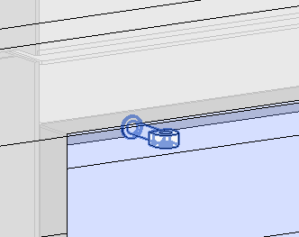
MMR Modularization
5
Removable Cladding Detail
■ Reference Details
■ Concept Modeling
Removable Area
Removable Area
■ Lifting Lug

Slide 11
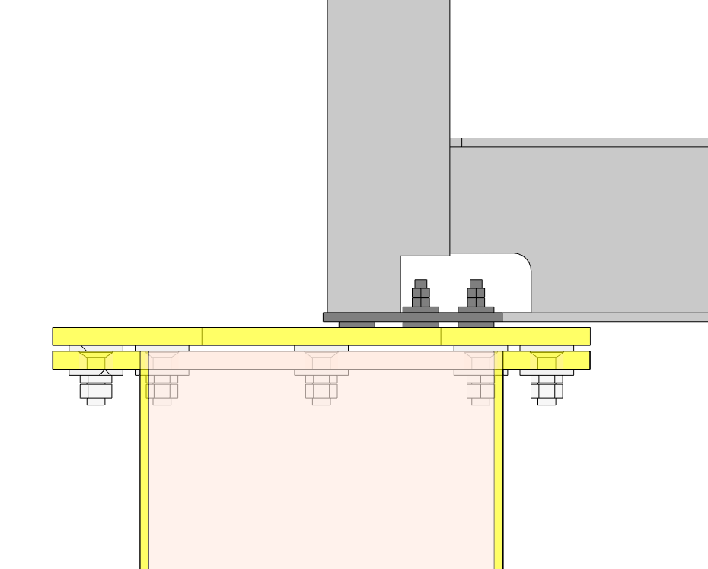
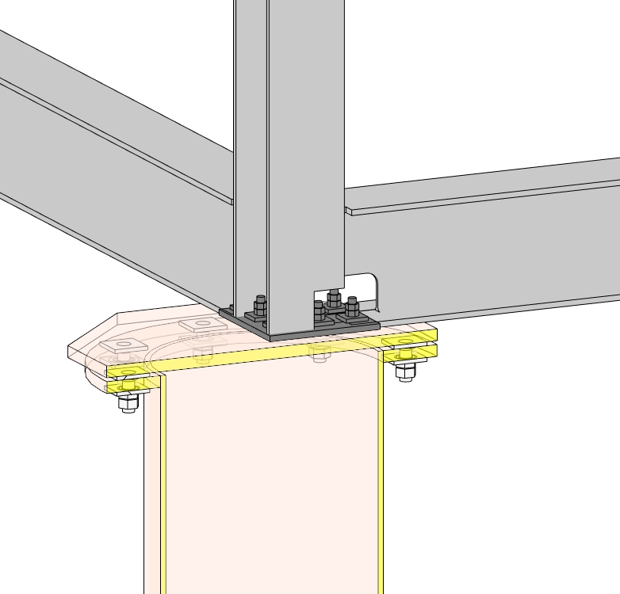
MMR Modularization
5
Steel module connection Detail
■ Connection Details
■ Concept Modeling
WEB OPENING
PL-220x220x15
Base plate (PL-30t)
Ring plate (PL-30t)
Plate Washer
PL-90x90x10 w/ bolt hole Dia.35mm
M30 ANCHOR

Slide 12
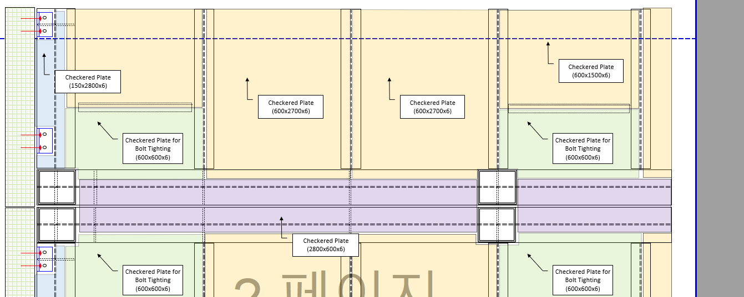
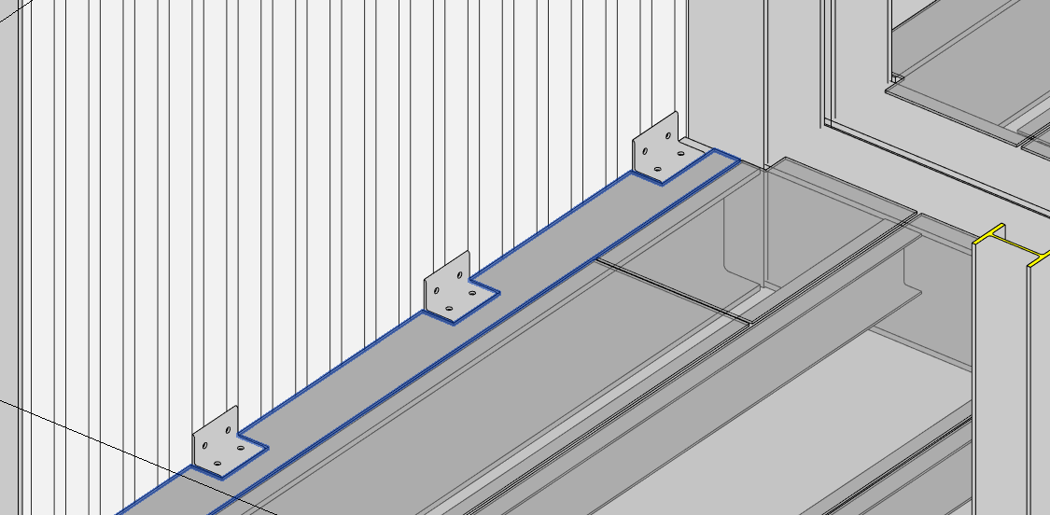
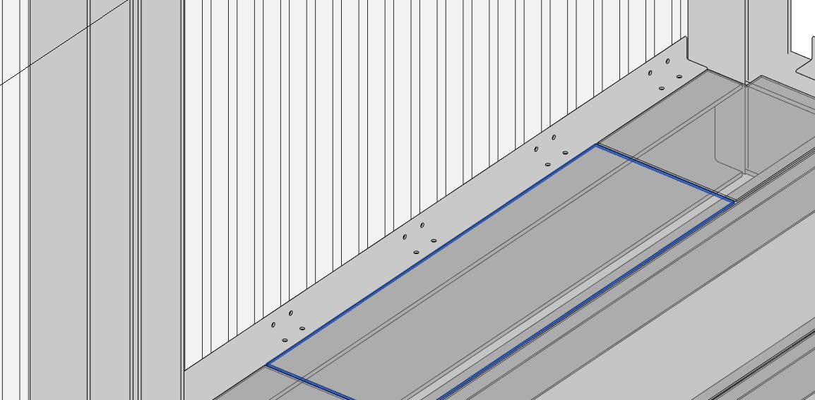
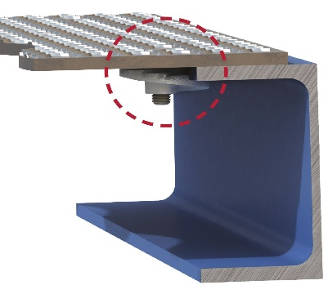
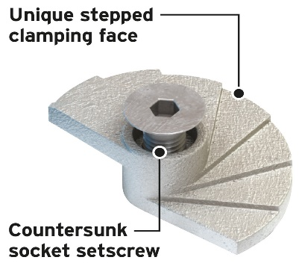
MMR Modularization
5
Panel fixing Detail
■ Reference Details
■ Concept Modeling
ALT 1
L-80x80x6@600
w/2-M12
Checkered Plate
(cut by angle position)
ALT 2
L-80x80x6@600
w/2-M12

Slide 13
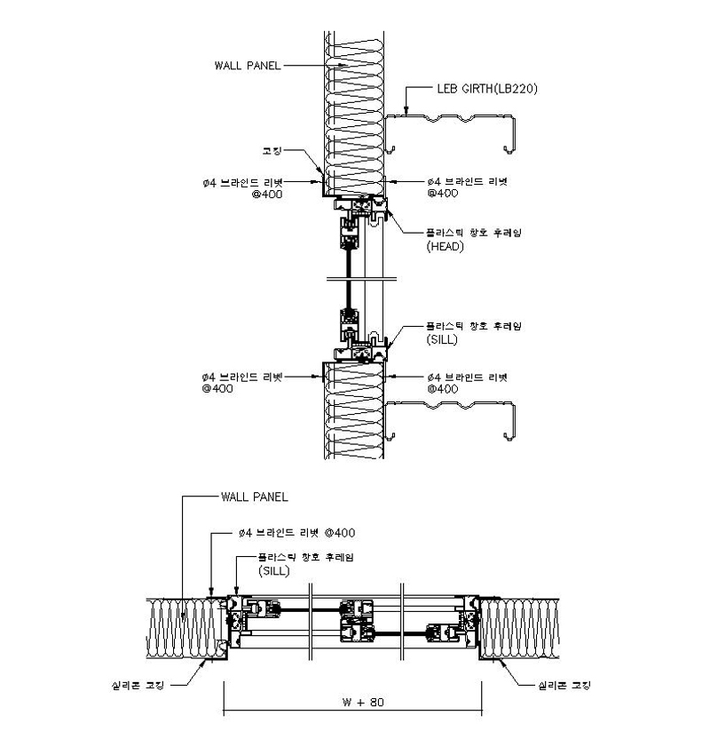
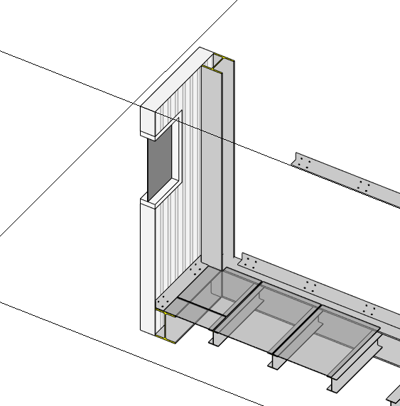
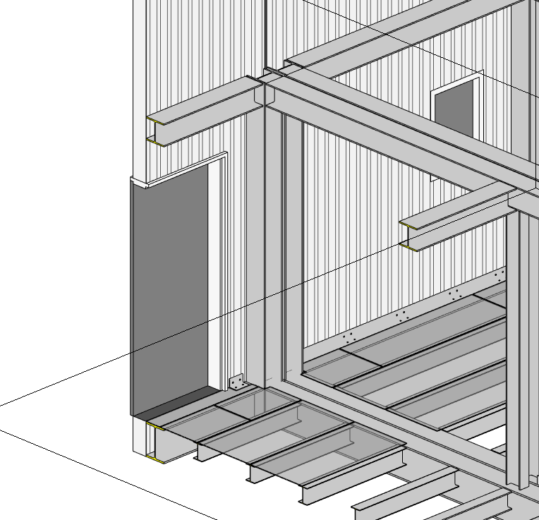
MMR Modularization
5
Door, Window, Louver fixing Detail
■ Reference Details
■ Concept Modeling

